Slide 1

DriverPass System Analysis
Prepared for: DriverPASS Leadership
Prepared by: Quazi Mainuddin
Notes:
Welcome, and thank you for meeting today. In this presentation, I’ll walk you through the proposed DriverPass system design. We’ll review the system requirements, core diagrams, security approach, and known limitations.
My goal is to explain how this design meets your needs for a modern, secure, and user-friendly platform for scheduling lessons, taking practice tests, and managing students and instructors.

Slide 2

System Requirements
Functional Requirements
Students can schedule, modify, and cancel driving lessons online.
Students can take practice driving tests and review progress.
Nonfunctional Requirement
The system must respond to common actions (login, booking, submitting a test) in 2 seconds or less
Notes:
Our first key functional requirement is the ability for students to book, change, or cancel lessons through a web or mobile interface. This directly supports your goal of offering flexible scheduling.
The second is online practice testing, which lets students prepare for their DMV exam and track progress over time.
On the nonfunctional side, speed is critical. We’ve designed for performance so the most common actions happen almost instantly — within two seconds — which keeps the experience smooth and frustration-free.

Slide 3
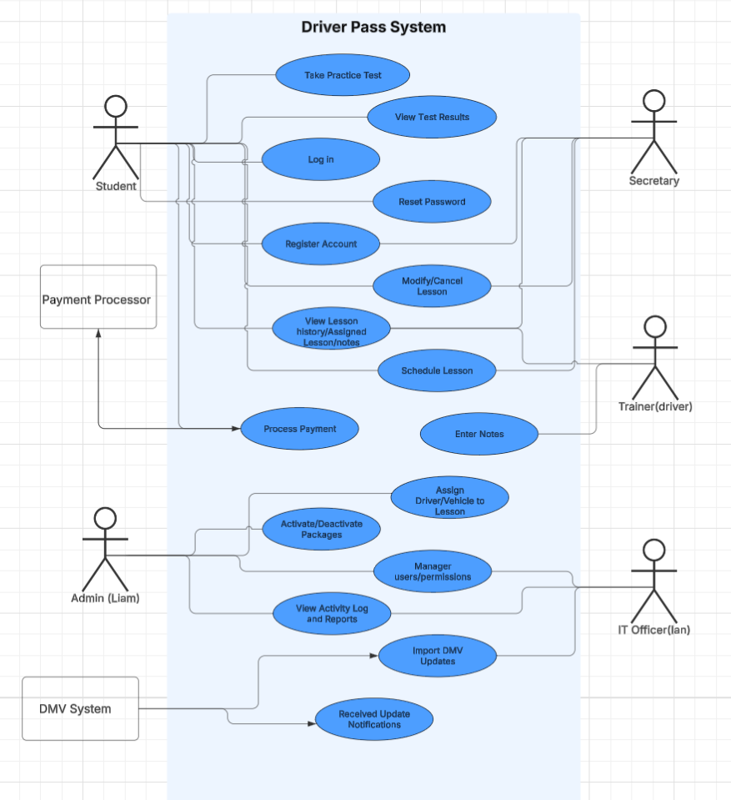
Use Case Diagram
Notes:
This diagram shows the main ways each user type interacts with the system. Students have access to scheduling, practice tests, and progress tracking. Secretaries can assist with bookings. Admins manage packages, users, and reports. IT officers handle DMV updates.
External systems like the payment processor and DMV interface are also shown here, because they’re essential for payment handling and keeping test content accurate.

Slide 4
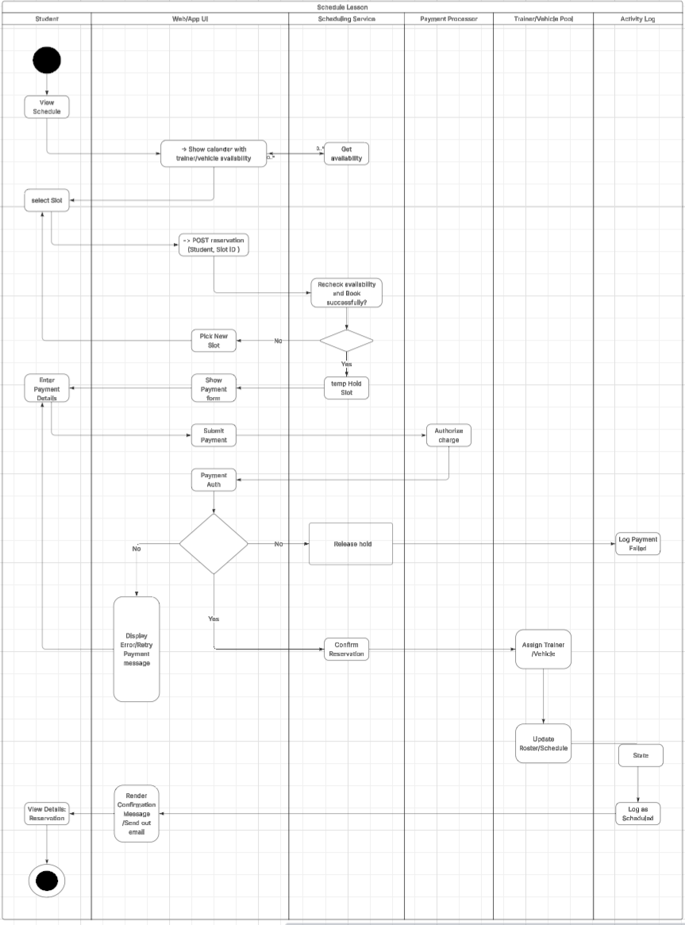
Activity Diagram
Notes:
This activity diagram walks through the scheduling process step-by-step. It starts with the student viewing available slots and ends with confirmation and notifications. Decision points are built in for checking slot availability and payment requirements. This process ensures no overbooking, integrates secure payment when needed, and logs every action for accountability.

Slide 5
Security
HTTPS encryption for all data in transit
Hashed passwords and optional two-factor authentication for staff
Role-based access control (Student, Secretary, Admin, IT Officer)
Account lockout after 5 failed logins
Email-based password resets with verification
Detailed activity logs for all critical actions
Notes:
Security is central to the design. We use HTTPS to protect all data traveling between the browser and server. Passwords are never stored in plain text — they’re hashed, and staff accounts can use two-factor authentication for extra protection.
Role-based access means people only see what they need for their role. Lockouts after repeated failed logins stop brute force attempts. Password resets go through email verification. And finally, activity logs track important actions so you can see exactly who did what and when.

Slide 6
System Limitations
Requires stable internet connection for access
Limited offline functionality
Payment processing depends on third-party provider uptime
DMV content updates require integration maintenance
Notes:
Like any cloud system, DriverPass requires a stable internet connection to work properly, and there’s minimal offline capability. Payment processing relies on our third-party provider, so if their system goes down, payments could be delayed.
Lastly, keeping DMV content accurate requires ongoing maintenance of the integration to handle any changes in their data format or API.

Slide 7
Thank You
Notes:
Thank you. Open for Q & A

